Slide 1

Instructor Notes
Ensure you update your contact information on the Title slide
This class is a combination of Lecture, Demo and Lab
Class duration is expected to be approximately 4 hours
All Demos and Labs are described in the slide Notes
File Power BI Adv M Final.pbix will be used by the students in Labs.
Save a copy of this file to add DAX and perform demos during class. It is easier to save a copy as in one demo, you will need to show “before and after” file sizes
Answers to the Knowledge Checks can be found in the Appendix
PBIX file has a FullPath parameter which can be adjusted to the location of the source data file VanArsdel_Actuals.xlsx
Download and install Power BI Desktop:
Download and install Microsoft Power BI Desktop from: http://www.microsoft.com/en-us/download/details.aspx?id=45331
Open Power Query Formula Language link
Version: March 2018
Notes:
Change Log
-March 2018
Added the Copyright
Add slide before summary about what happens if data does not have a connector
Added data type of Zip in Customer
after data model def, add decision tree to determine which connection mode to make
Added slide and class discussion on how to break up a denormalized file

Slide 2
Version: March 2018
Notes:
.

Slide 3
Prerequisites and Setup Steps
Internet connectivity: You must be connected to the internet
At minimum, a computer with 2-cores and 4GB RAM running one of the following version of Windows: Windows 7,
Windows 8, (64-bit preferred), Windows 8.1 or Windows 10 or Windows Server 2008 R2 or Windows Server 2012/R2
Microsoft Power BI Desktop requires Internet Explorer 9 or greater
Verify if you have 32bit or 64bit operating system to decide if you need to install the 32bit or 64bit applications.
Search for computer on your PC, right click properties for your computer
You will be able to identify if your operating system is 64 or 32 bit based on “system type” as shown below
Download and install Power BI Desktop: Download and install Microsoft Power BI Desktop from http://www.microsoft.com/en-us/download/details.aspx?id=45331. Optionally, you can also install the Power BI Desktop tool from the Power BI Desktop Install folder on the flash drive that will be provided on the day of the session. Please choose appropriate 64-bit or 32-bit version depending on your platform. Microsoft Power BI Desktop is available for 32-bit (x86) and 64-bit (x64) platforms
Download Class Files:
Copy Files from your USB to C:\Power BI_Adv_M\ (Please return the USBs)
Open a browser to the Power Query Formula Categories page: https://msdn.microsoft.com/en-us/library/mt253322.aspx
NOTE: This lab is using real anonymized data and is provided by ObviEnce LLC. Visit their site to learn about their services: www.obvience.com .
This data is property of ObviEnce LLC and has been shared for the purpose of demonstrating PowerBI functionality with industry sample data. Any uses of this data must include this attribution to ObviEnce LLC.
Notes:
Update Title Slide:
Instructor Name, Title & Company
Instruct the students to copy the files (note, as the Module 4 Lab: Creating Parameters and Paths has them creating a dynamic path, they actually can put the files wherever they want to).

Slide 4
COURSE OBJECTIVES
By the end of this course, you will be able to use Power BI Desktop to import and shape data from a variety of different sources. Specifically you will be able to:
Understand the Power BI Desktop data model, its components and most effective schemas
Gain an understanding of the Power Query M language
Import data from a variety of sources (including XLS and CSV files)
Create queries using toolbar navigations and Advanced Editor
Understand parameters
Organize queries using folders

Slide 5
COURSE AGENDA
Introductions and Overview
Module 1: Basic Data Modeling
Module 2: Getting Started with M (Power Query Language)
Module 2 Lab: Import and Basic Transform
Module 3: Advanced M Transformations
Module 3 Lab: Complex Transformation
Module 4: Variable and Parameters
Module 4 Lab: Creating Parameters and Paths
Wrap-up & Questions

Slide 6
Module 1 – Discovery
Notes:
So let’s talk about our approach and discovery. Before you know the skills or even if you are a skill master, if you do not know your data then you are going to have a difficult time.

Slide 7

Who are we?
VanArsdel
Manufactures and sells sporting goods
Has invested heavily in R&D for products for customers
Sales come from its own manufactured products and other manufactures
Sells directly to consumers nationwide & international
The Request
The CMO wants a sales & market share analysis
What product categories and segments show recent trends
What product segments are meeting our Budget goals?
How well do VanArsdel’s products sell compared to 3rd Party?
How do we perform nationwide vs. international for our products?
Notes:
So let’s start with who are we and what are we dealing with?
We work at a company named VanArsdel – they manufacturer and sell sporting goods. They sell 3rd party and their own. They have lately (CMO) have been investing in Research & development for the products they create; The marketing team proved that customers are looking for certain types of products based on their own life style.
We are on the Data Analyst at the company – we work with the Marketing & Sales department.
The product team needs to know what to focus their time on, and the CMO wants to see where VanArsdel has the greatest opportunity.
Not only this, but it cost more to sell 3rd Party products outside the US – how does nationwide vs. Int. compare?

Slide 8
Where do we Start? Ask the Right Questions
Start with answering basic questions about your project
What Data do we need?
What fields and tables are required to answer the questions?
What Data do we have?
What do I have currently have that is relevant to this project?
What Data do we transform?
What data do I need to optimize to be in the correct shape?
Notes:
So know we know the challenge, where the heck do we start?
Any solution or Report you work always begins with getting data. With this in mind, you should ALWAYS ask and answer 3 basic questions before you start on any visual.
This applies even if you know the data and have been working with the same data for years. Each request and solution is different.
What Data do we need? Always document what fields and data you must have.
What are the main metrics, values, and fields that you will be reporting on? What do you need to help describe your data (rolling up, grouping)?
What Data do we have? Where does is the data coming from?
Once you know what you need and how you need it, you can begin to acquire the right sources. What about the formats/types of it? Does it work?
What Data do we transform?
If you do not have what you need originally, this is where we start so we can create or remodel and get what we need.

Slide 9
What Data do we Need?
Small Group Time! Get together and document the needed tables/columns, etc.
What am I counting or aggregating?
Include what aggregations (measures) and facts needed
Transactions
Revenue
Cost
How do we Describe the Data?
Include what dimensions and attributes that must describe the “facts” and be able to roll up into
by Month
by Customer
By GEO
Notes:
So let’s do this together – based on the scope of the project, get into groups of about XX to write down what you think you need.
Make sure to document both what are the Facts (counting or aggregating) and what dimensions you need (what describes the facts).

Slide 10
What Data do we Need – Exercise
Document the following:
What do I need aggregate or count?
What is required to describe and provide granularity to my facts?
The Request
The CMO wants a sales & market share analysis
How well do VanArsdel’s products sell compared to 3rd Party?
How do we perform nationwide vs. international for our products?
What product categories and segments show recent trends
How do we compare this year vs. last year?

Slide 11
What Data do we Have?
Explore the Data! (USSales Folder)
Import the data into a new Power BI Model
What is the source of the data?
What is the formats?
What is the current shape?
How does this match with what we Need?
What am I counting?
What am I describing?
What is missing or is the wrong shape?
Notes:
Ok – with the basis of what you need, let’s start by importing the data.
We have 2 files. A Sales file in CSV and a Dimension file as Excel Workbook.
Go through it and see if this goes back what you need.

Slide 12
What Data do we Have - Exercise
BI_Dimension file – Excel
Product Table
ProductID
Category (missing data)
Price (not number) Product (Not Split)
GEO - sheet
As sheet – not clean
Wrong Data types
Manufacturer – sheet
Not right layout (columns)
Sales file – csv
Facts
Units
Revenue
Dimensions
ProductID
Date
Zip
ManufacturerID
Notes:
The Sales file is just US, and we see the following:
ProductID, Date, Zip, ManufacturerID for our dimensions.

Slide 13
What Data do we Transform?
What transformations are needed?
One file is a CSV (Sales transactions or Fact Table)
We need to describe sales by Product (category, type), Manufacturer, GEO
The BI_Dimension excel file has multiple worksheets…
What to fix
How do we format Product?
How do we format Manufacturer?
GEO?
Notes:
Ok, so now that we have explored what we have, we know that we need to optimize the shape of some the data.

Slide 14
Ask the Right Questions
What Data do we need?
Product Sales that contain information on location, date, manufacturer, product details
What Data do we have? (USSales Folder)
Sales table (sales.csv) & Dimension Excel file
Current Shape is wrong for some dimension files
What Data do we transform?
Reshape Manufacturer file to have unique ID
Optimize Product table to be able to report
Fix GEO table to match to Sales Zip

Slide 15
Questions?

Slide 16
MODULE 1b:
Basic Data Modeling

Slide 17
MODULE OBJECTIVES
Objectives:
Understand the basic architecture of PBI Desktop
Understand Power BI modeling terminology

Slide 18


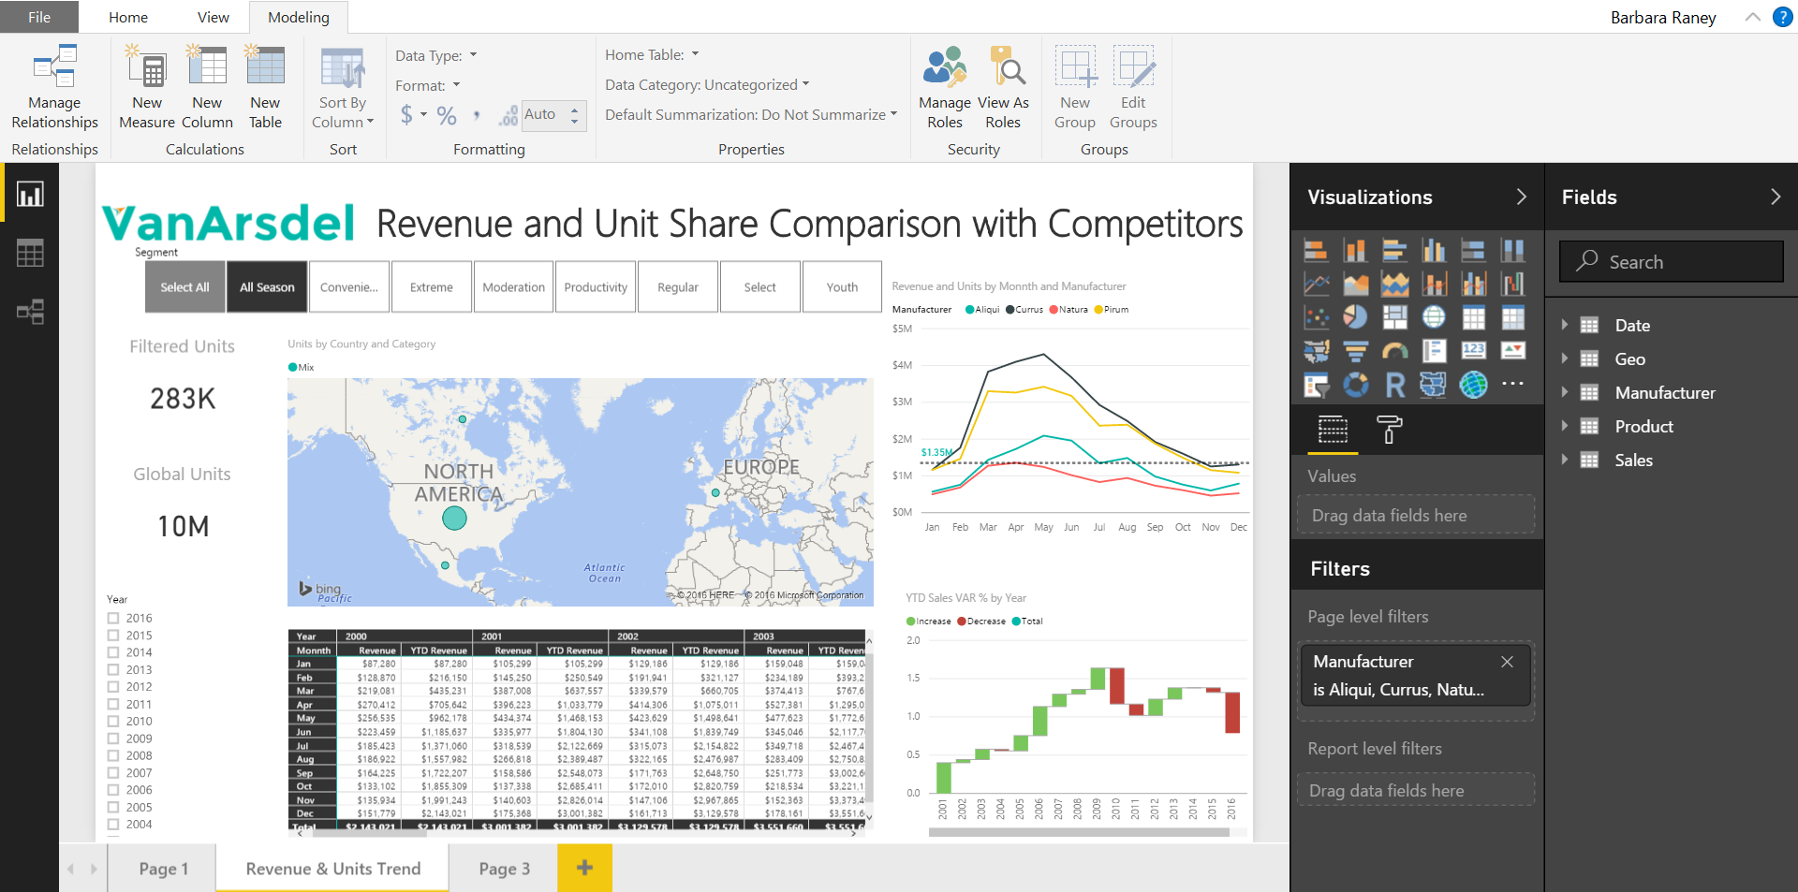
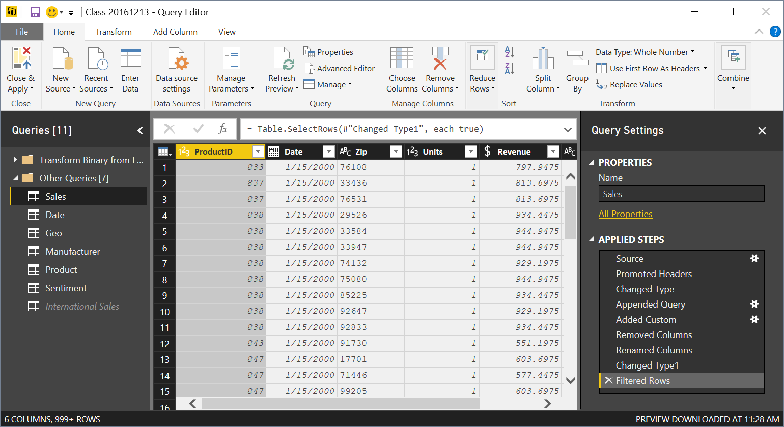

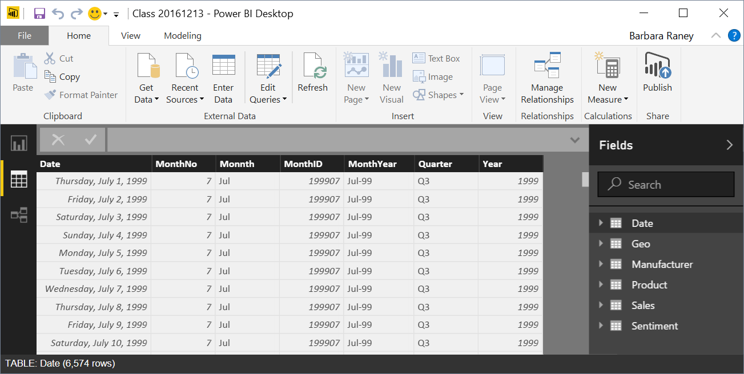
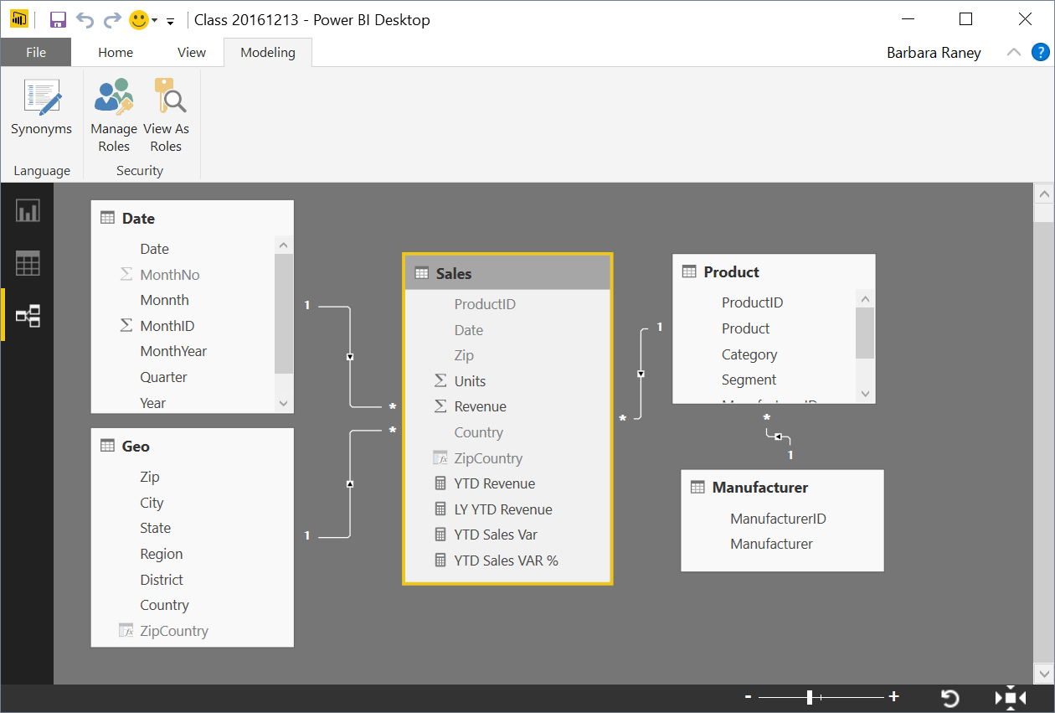


Power BI Desktop Data Flow
Data Sources
Power BI Desktop file (.PBIX)
Report
Create Visuals
Close & Apply
Close: Closes Query Editor
Apply: Loads data from sources to Data Model
Data
View Tables
Query Editor
Data Source Connections
Data Transformations
(Prep data for Data Model)
Relationships
See how Tables relate to each other
Notes:
This slide builds automatically.
Depicts the data flow for Power BI Desktop along with what is in a PBIX file.
Note all the data sources that can be pulled into Query Editor.
Note the different views (Report, Data, Relationships) once all of the data is pulled in.

Slide 19
What is a Data model?
Improves understandability of the data
Increases performance of dependent processes and systems
Increases resilience to change
Why is it important to have a Good Data model?
Notes:
In a good Data Model, the model can assume that column types are homogeneous (as they are strongly typed). This is different from Excel, where any given cell in a spreadsheet can contain different data types.

Slide 20
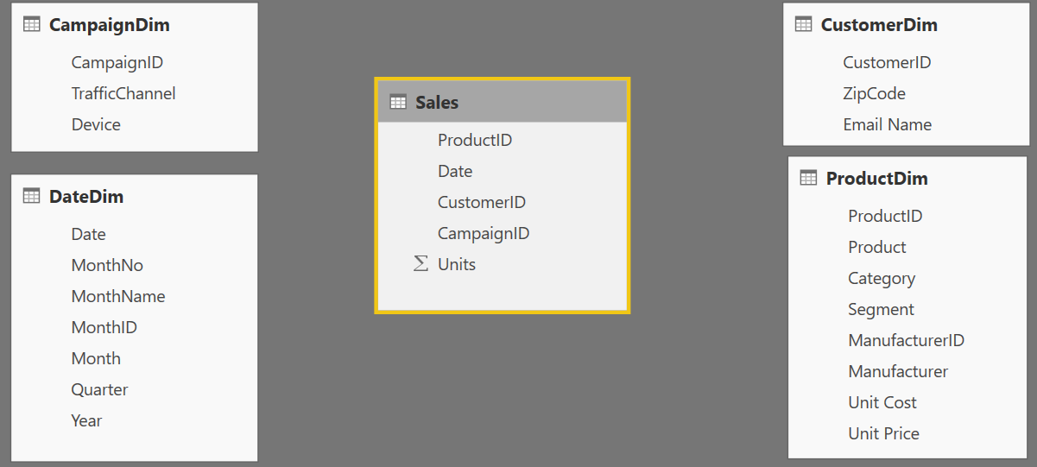
Components of a data model – Fact Table
Basic Data Modeling
Fact
Table
Fact Table
Contains Measures (or items to be aggregated) of a business process Examples:
Transactions
Sales Revenue
Units
Cost
Measures are usually sliceable.
Examples:
By Month, By Customer
Notes:
The items that are math will be our facts: Actual & Budget Revenue Units and Cost
Possibly use a finance example: the Fact would be the general ledger, the dimensions would hold the account lists / descriptions.

Slide 21
Components of a data model – Dim Table
Basic Data Modeling
Dim
Table
Dim
Tables
Dim
Table
Dim
Tables
Dim Table
A Dim (or Dimension) table contains descriptive attributes that define how a fact should roll up.
Examples:
By month,
By Customer, By Geo
Notes:
The BY’s will be the dimensional attributes that we will use to describe the facts.

Slide 22

Components of a data model - Relationships
Basic Data Modeling
Relationships
Connection between a 2 tables (usually fact & Dim tables) using columns from each
3 kinds of Relationships
1 to Many
1 to 1
Many to Many
(with a bridge table)
Relationships
Relationships
Notes:
A Relationship is analogous to how an Excel VLOOKUP function brings two tables together
Can observe which side is the many (*) and which is the one (1) - CARDINALITY
When you draw the relationship, Desktop does several heuristic things
It checks that one side of the relationship is the “One” and the other is the “Many”
Directions of Relationship
Uni-directional are created by default and allows filters to get passed from attribute (dim) table to the Fact
Bi-Directional relationship allow you to pass filters in both directions
This is different than Many to Many
There is a significant performance penalty for Bi-Directional filtering

Slide 23
Data Model Brings Facts and Dimensions Together
Basic Data Modeling
Type of Data Models
Star Schema
Snowflake Schema
Flat or Denormalized
Note: This is not an exhaustive list, but are the most common model types used by Power BI.

Slide 24
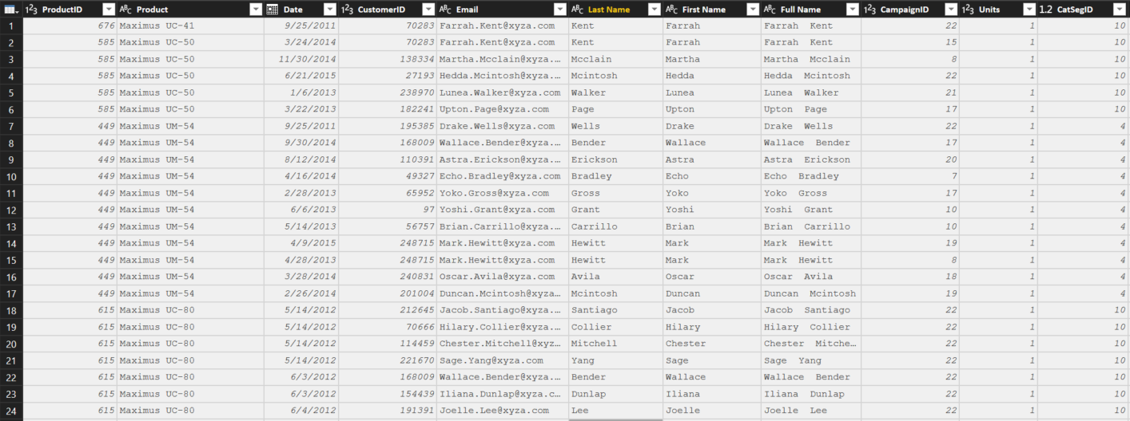
Flat or Denormalized schema
Basic Data Modeling
All attributes for model exist in a single table
Highly inefficient
Model has extra copies of data > slow performance
Size of a flat table can blow up really quickly as data model becomes complex
Notes:
Depending on students, you may want to mention that Power Query can easily create this type of schema – which actually can be beneficial when reporting data using Tableau.
I sometimes call this one the “Kitchen sink” schema.

Slide 25
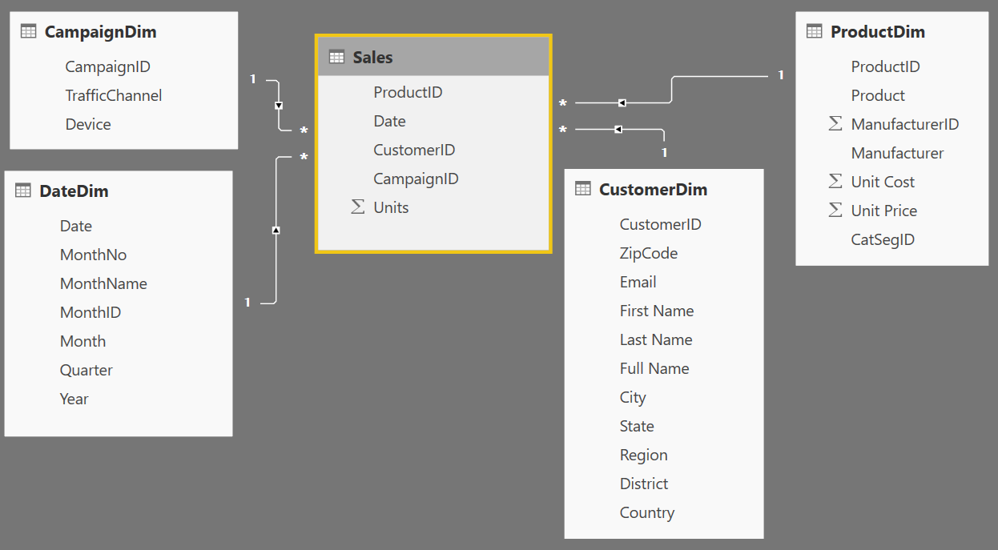
Star Schema
Basic Data Modeling
1
Many
1
1
Fact table in the middle
Surrounded by Dims
Looks like a ‘Star’
Fact table is the “Many” side of the (one to many) relationship
Notes:
By extracting the repeated attributes to dimension tables, you are lowering the amount of memory required by the data model.

Slide 26
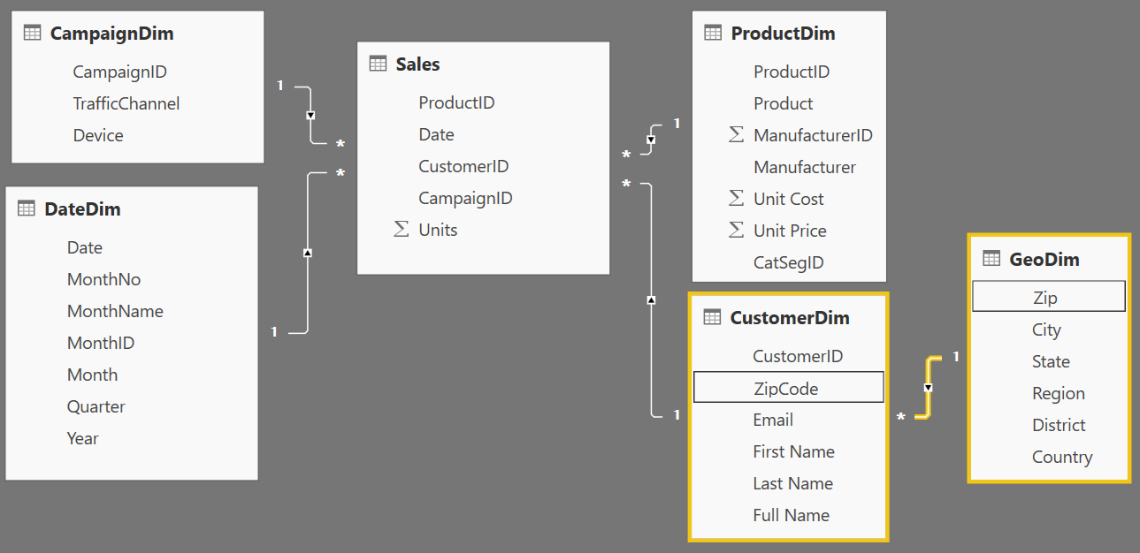
Snowflake Schema
Basic Data Modeling
Center is a Star schema
Fact table in middle
Surrounded by Dims
Dims “snowflake” off of other Dims
If you have many, it looks like a ‘Snowflake’
Dim or Fact tables can be the “Many” side of the relationship
Dims
Facts
Dims
Flake
Snowflake
Notes:
“Snowflaking” off tables can be very beneficial when your dimensions have several repeating attributes that can be extracted to their own table.
So the CustomerDIM would be like the kitchen sink schema if you didn’t branch the Zip off to a GeoDim and have to repeat the city, state, region, etc over and over again making this less efficient.

Slide 27
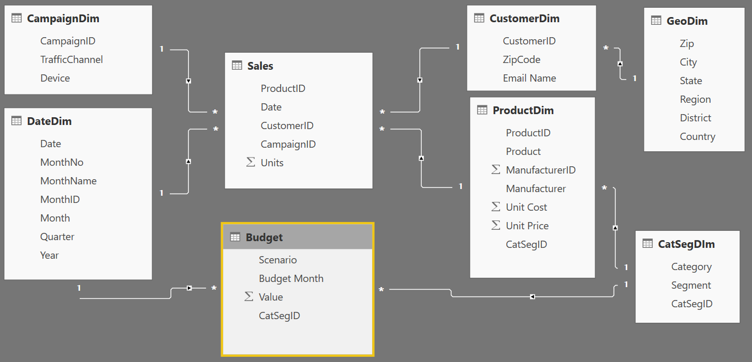
Granularity & Multiple Fact
Basic Data Modeling
Grain (granularity) measures the level of detail in a table
Example:
One row per order or per Item
Daily or Monthly date grain
If your facts have very different granularities, split them into Multiple Fact tables & connect them to shared dimensions at the lowest common granularity.
SalesFact (Daily by Product)
BudgetFact (Monthly by Product Category & Product Segment)
Notes:
Keep in mind, your measures (calculations) should be placed on a fact table, but it really does not matter which one. The key is that measures should not be placed on dimension tables. If students want more detail on Why, send them to the DAX class for more detailed discussion.
When you have a fact at the Month grain, like budget, you can create a calculated column which holds the first (or last) day of the month to use in creating the relationship. One of the key takeaways is that what you slice by all come from your attribute (Dim) tables

Slide 28
Data Types
Numeric Data Types
Whole Number
Decimal Number
Fixed Decimal Number (Floating point stored as integer)
Boolean
Date/Time Data Types
Date – Internally stored as an integer
Time – Internally stored as a fraction between 0 and 1
Date Time
Other Data Types
Text
Any – You should never see this in a data model. Bad things can happen!!
Set your Data Types in the Query Editor
Set your Data Formats ($ %, etc) in the Data Model
Pro Tip: Data type is different from data format
Notes:
Data Types are how data is stored, as opposed to Data Formats which are how data are displayed
Discuss the difference between Fixed Decimal (Currency) and Decimal (which has floating decimal)
Fixed Decimal is 19.4 – 19 places to left of decimal and 4 to the right, which allows for proper processing of pennies. Best for Currency numbers.
Decimal can be less efficient when the data has excessive precision
Discuss splitting DateTime into Date and Time columns so that they compress better
Fixed Decimal numbers – stored like whole number uses less memory than Decimal

Slide 29
Designing good data models
Star Schema – Go to structure for most Data Models
RAM is precious !!!!!
Some Tips and tricks to save RAM and increase speed of model
If a fact table contains an ID field which is unique for each record, remove it
Ex. Transaction ID
Sort columns before bringing them into a Power BI data model
Change all of the ANY data types to an appropriate Data Type
Notes:
* When the file is closed – it is saved to the hard disc
When opened, the DB is stored in RAM (Approx 60% of machine’s available RAM)
Hard Disk has mechanical parts - read/writes are slower
In-Memory – read/writes are faster
RAM is precious, and the PowerBI team uses many techniques to compress data
In the Service, datasets are limited to 1 GB.

Slide 30
KNOWLEDGE CHECK
What allow tables in the data model to “talk” to one another?
Relationships
2. What type of schema has all attributes for model in a single table?
Denormalized or “Flat” – Kitchen Sink
3. When would you use multiple Fact tables
Multiple Reasons
Different Time Grains
Different dimensional attributes
One dimension at different grain: Product v. Product Category
Facts are sourced from different systems with different refresh cadences.
Notes:
Relationships
Denormalized or “Flat” – the Kitchen Sink Schema
Multiple Reasons
Different Time Grains
Different dimensional attributes
One dimension at different grain: Product v. Product Category
Facts are sourced from different systems with different refresh cadences.

Slide 31
MODULE 2: Getting Started with M
(Power Query Language)

Slide 32
MODULE OBJECTIVES
Objectives
Understand the basics syntax of the M Language
Understand function & keyword structure
Understand how to connect to data
Understand the basic structure of the Advanced Editor
Agenda
Power BI M Language Overview
Basic Data Import
Introduction to Text functions
Create and Apply Degenerate Dimensions
Notes:
In the first module, we explored the data components of the Power BI architecture and best practices in data modeling. Along the way, we learned some Power BI terminology and how to organize our data within the tool. Now, we will explore the Power BI power query language, M, to deepen our knowledge and walk through how to import data from a variety of sources

Slide 33








M has amazing capabilities to transform data to optimize it for the data model
Why M?
Notes:
Take data from disparate sources and transform it into the correct “Shape” for the data model.

Slide 34
How do I use M?
Three ways to write M
Click and Adjust
Custom Code
Use the Ribbon
Simple
Advanced
Notes:
There is nothing wrong with using the UI to create your queries, but the language is SO much more powerful than just what is in the UI. By learning how to read the code generated from the UI and then updating it to suit your needs, you can accomplish incredible transformations.

Slide 35
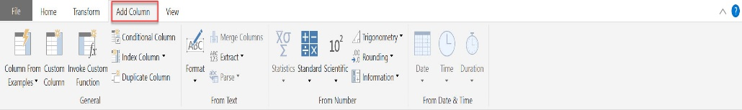
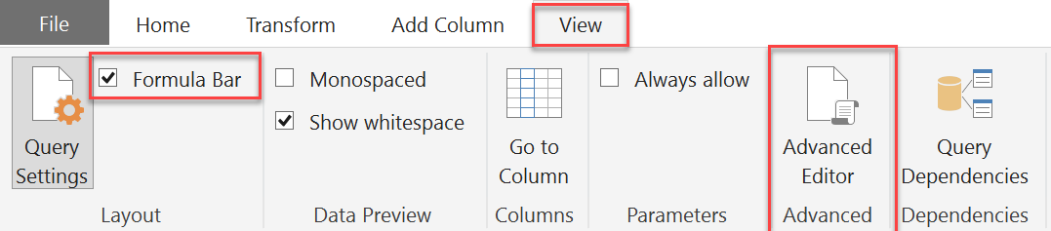
Key Concepts of M syntax
M is the key to data transformation in Power BI
Many transforms are just a click away on the Ribbons
Turn on Formula Bar to see M syntax generated by clicks
View full syntax in Advanced Editor
M is Column Based
Many Transformations occur by adding columns
M is CaSe SeNsItIvE!
Notes:
Walk thru each of the four ribbons. Note that this is in Power Query and we haven’t connected to any data so if they just open PowerBI, they will not see this unless they open Power Query.
This is probably a good time to remind the students that the product is updated monthly, so the icons may shift a bit on the ribbons.
Point out how to turn on the Formula Bar – if they haven’t connected to a data source yet, the option to turn it on might be greyed out

Slide 36
Key Concepts of M syntax
M Formulas
Foundation of transformations
Syntax: Object.Action()
Objects: Table, List, Record, Text, Number, Date, etc.
Actions (Camel Case): ToList, DayOfWeek, ToNumber, FromText, etc.
M helper Words
little helper words – never capitalize these
let in each
if then else
true false error
and or not
try otherwise
as is meta section shared type
M # Key Words
Used to create new artifacts and literals
#date(2016,01,01) #date([Year],[Month],[Day])
#datetime(2016,02,26, 09,15,00)
#time(09,15,00)
#datetimezone(2013,02,26, 09,15,00, 09,00)
#table({"X","Y"},{{0,1},{1,0}})
#duration(0,1,30,0)
#binary #infinity #nan #sections #shared
Key Punctuation
[Column] - To reference a Column
{List} – use {} to indicate a List
M is CaSe SeNsItIvE! Power Query Formula Language
Notes:
Navigate to Power Query Formula Categories. Power Query Formula Language Show the students that it scrolls to show all formulas currently documented. Click on one formula to see its detail help page. Tease that we will be coming back to that page.
Discuss case sensitivity, that M Formulas are camel-cased, and the helper words are always lower case.

Slide 37
Text Functions
Position
M
Excel
0 1 2 3 4 5 6 7 8 9 10
1 2 3 4 5 6 7 8 9 10 11
My Column
A B C 1 2 3 4 5 x y z
A B C 1 2 3 4 5 x y z
Return "ABC"
Text.Start([MyColumn], 3)
LEFT([MyColumn], 3)
Return "234"
Text.Range([MyColumn],
4
, 3)
MID([MyColumn,
5
, 3)
Find position of "5"
PositionOf([MyColumn], "5") =
7
SEARCH("5", [MyColumn]) =
8
Notes:
* M is 0 index based, so Text.Range & Text.PositionOf start counting at 0
** Excel MID & SEARCH are 1 index based – start counting at 1
Also, specifically call out why Excel differs from M on the Text.StartsWith([MyColumn],”abc”) example: Excel is not case sensitive.

Slide 38
Text Functions
M Function Syntax | Excel Syntax | M Output
Text.Start([MyColumn], 3) | LEFT([MyColumn], 3) | ABC
Text.End([MyColumn], 4) | RIGHT([MyColumn], 4) | 5xyz
Text.Range([MyColumn], 4, 3) * | MID([MyColumn], 5, 3) ** | 234
Text.Range([MyColumn], 4) * | MID([MyColumn], 5) ** | 2345xyz
Text.StartsWith ([MyColumn], "abc") | IF(LEFT([MyColumn], 3)=“abc” , TRUE(), FALSE()) | FALSE (Excel -> TRUE)
Text.StartsWith ([MyColumn], “ABC") | IF(LEFT([MyColumn], 3)=“ABC”, TRUE(), FALSE()) | TRUE
Text.Length([MyColumn]) | LEN([MyColumn]) | 11
Text.Contains ([MyColumn], "123") | IF(ISNUMBER(SEARCH(“123", [MyColumn])),TRUE(), FALSE()) ** | TRUE
Text.PositionOf ([MyColumn], "5" ) * | SEARCH(“5", [MyColumn]) ** | 7 (Excel -> 8)
M is CaSe SeNsItIvE!
* M is 0 index based, so Text.Range & Text.PositionOf start counting at 0
** Excel MID & SEARCH are 1 index based – start counting at 1
Notes:
Pick a couple of the functions as examples and walk thru the syntax difference between M and Excel.
Ensure you comment on one of the examples with an asterisk *, as they have the concept of Zero index vs. One Index.

Slide 39
if … then … else
Basic Syntax: if <test if true> then <result if true> else <result if false>
if’s Can be chained or nested
No parentheses () are required, except
When if test or results have multiple conditions:
(condition 1 and condition 2)
(condition 1 or condition 2)
(condition 1 or (condition 2 and condition 3))
If multiple if’s are used ensure you have the same number of “if”, “then”, “else”
Simple example (1 each of if, then & else)
=if [Column2] = "Key" then [Column2] else “Other”
Chained example (3 each of if, then & else)
=if Text.EndsWith([Column2],"Key") then [Column2] else
if [Column2] = "TotalCost" then "Cost $" else
if [Column2] = "SalesQuantity" then "Sales #" else null
Nested example (3 each of if, then & else)
=if Text.EndsWith([Column2],"Key") then
if [Column2] = "TotalCost" then "Cost $" else
if [Column2] = "SalesQuantity" then "Sales #" else null
else “Item #"
Multiple conditions example (1 each of if, then & else)
=if (Text.Length([Column2]) = 3 or Text.Length([Column2]) = 2 )
then true else false
M is CaSe SeNsItIvE!
Notes:
Keywords if then else are always lower case
Use () around multiple tests or conditions
Key Concept when debugging if… then… else
If you are using multiple if’s ensure they are evenly matched:
For each if, you MUST have a then AND an else
If you have 4 if then 4 then and 4 else
The result has to have one answer.

Slide 40
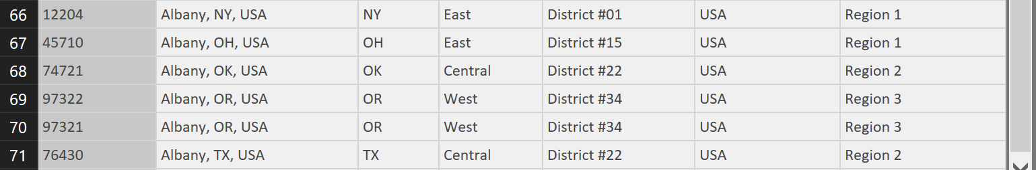
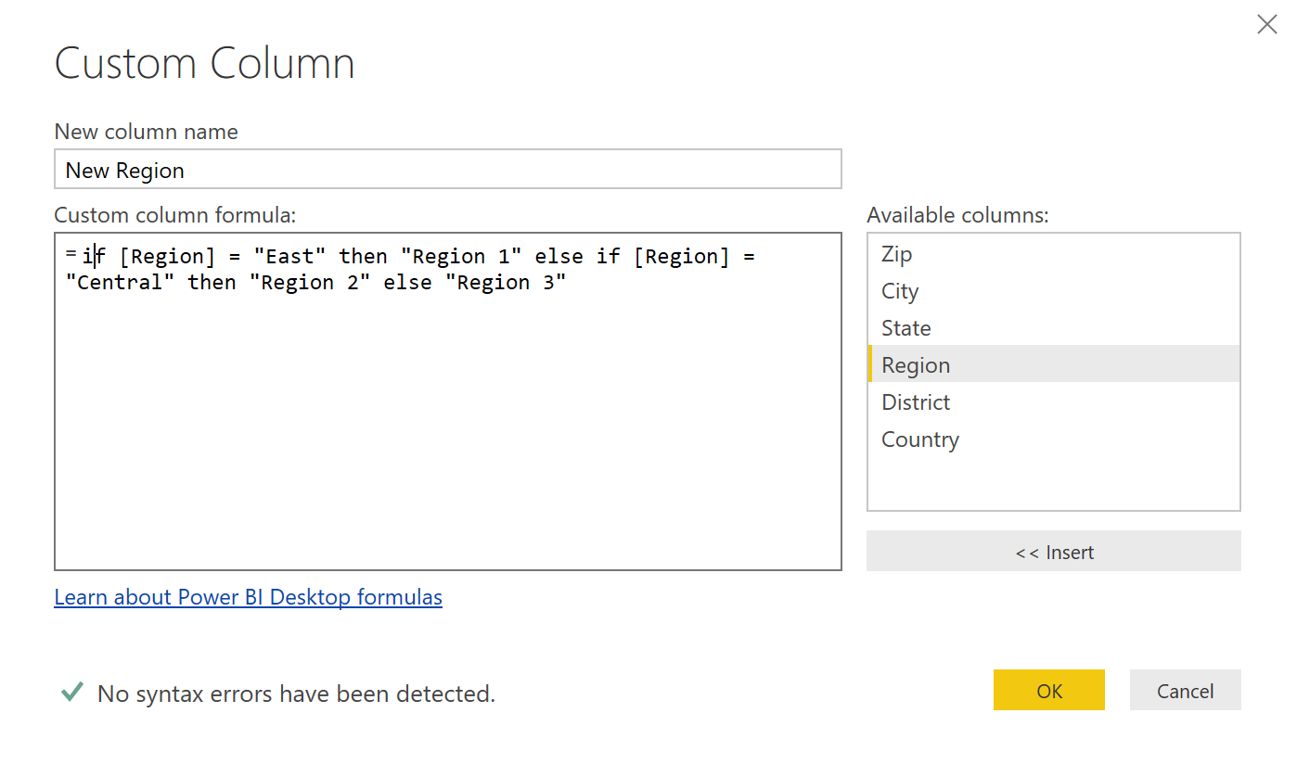
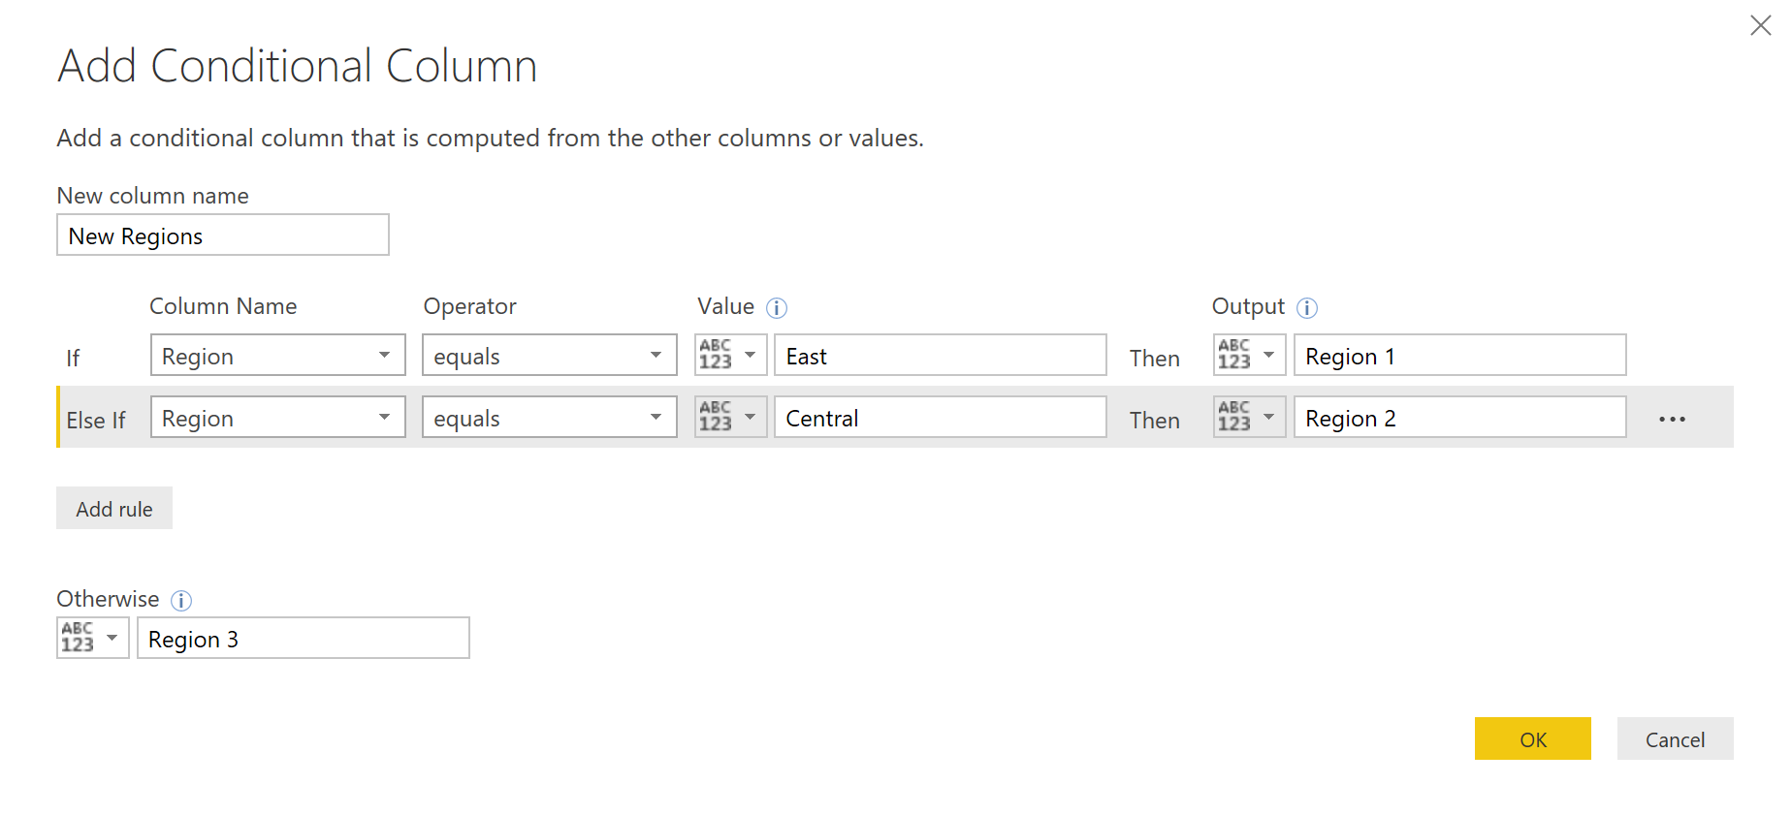
if … then … else using Conditional and Custom
Whether you use Conditional Column or Custom Column, the results are the same
1. How it reads in the formula bar when using the Conditional Column format
2. When using the Conditional Column format
Notes:
Main point here is how a Conditional Column looks to create the if..then..else statements and how that code appears in the Formula Bar vs if you added a Custom Column and wrote the code yourself. Same results.

Slide 41
Module 2 Lab:
Import and basic transform

Slide 42
We report on Actual & Budget Revenue; Units, Cost & Gross Profit
Who are we?
VtB – Actual Variance to Budget
YoY – Year over Year
MoM – Current Month vs Prior Month
One Division percent of Total
How we describe the data
By Product Category
By Product Segment
By Campaign
By Customer
Notes:
This is the same VanArsdel from Dashboard in a Day class, but tweaked for this class.
So let’s start with who are we and what are we dealing with?
We work at a company named VanArsdel – they manufacturer and sell sporting goods. They sell 3rd party and their own.
We are on the Data Analyst at the company – we work with the Marketing & Sales department.
There is a growing concern at the company that VanArsdel’s own products are struggling compared to similar 3rd Party products. The product team needs to know what to focus their time on, and the CMO wants to see where VanArsdel has the greatest opportunity.
Not only this, but it cost more to sell 3rd Party products outside the US – how does nationwide vs. Int. compare?

Slide 43
Who are we?
VanArsdel
Manufactures and sells sporting goods
Has invested heavily in R&D for products for customers
Sales come from its own manufactured products and other manufactures
Sells directly to consumers nationwide & international
The Request
The CMO wants a sales & market share analysis
What product categories and segments show recent trends
What product segments are meeting our Budget goals?
How well do VanArsdel’s products sell compared to 3rd Party?
How do we perform nationwide vs. international for our products?
Notes:
So let’s start with who are we and what are we dealing with?
We work at a company named VanArsdel – they manufacturer and sell sporting goods. They sell 3rd party and their own. They have lately (CMO) have been investing in Research & development for the products they create; The marketing team proved that customers are looking for certain types of products based on their own life style.
We are on the Data Analyst at the company – we work with the Marketing & Sales department.
The product team needs to know what to focus their time on, and the CMO wants to see where VanArsdel has the greatest opportunity.
Not only this, but it cost more to sell 3rd Party products outside the US – how does nationwide vs. Int. compare?

Slide 44
We report on Actual & Budget Revenue; Units, Cost & Gross Profit
Who are we?
Main Requests
Actual / Budget – Actual % to Budget
Unit Cost vs. Unit Profit
Year over Year Revenue
Month to Date/Prior Month
Revenue % of Category
How we Describe our Data
Product Category & Segment
By Customer
By Date & GEO
By Budget vs. Actuals
Notes:
Now, we need to go back to that “Data Discovery”:
Let’s review… We need to answer for Unit cost/profit, looking at this by time, and based on my “tone” on certain items, very much on how Product Segments & categories compare.
We describe VanArsedel’s data based on Product Category/Segment (Segment is baseically who customer lifestyle)
By Customer, by Dates, and looking at per unit cost & profit.

Slide 45
Where do we Start? Ask the Right Questions
Start with answering basic questions about your project
Question 1:
What Data do we need?
What fields and tables are required to answer the questions?
Question 2
What Data do we have?
What do I have currently have that is relevant to this project?
Question 3
What Data do we transform?
What data do I need to optimize to be in the correct shape?
Notes:
Where did we leave off? We have to go through Data Discovery & have a firm understanding of the data we are going to be using. Before any transformations & formulas, we have to start with the basic understanding of our data.
What Data do we need? Ok – remember the Discovery questions. It starts with what? What do I need in regards to dim tables & Fact Tables?
Sales, Product Cost/Price, Dates, Category & Segments, Budget data
Always document what fields and data you must have.
What are the main metrics, values, and fields that you will be reporting on? What do you need to help describe your data (rolling up, grouping)?
What Data do we have? Now we have to review the files. Who has looked through the files? Anyone?
Where does is the data coming from?
Once you know what you need and how you need it, you can begin to acquire the right sources. What about the formats/types of it? Does it work?
What Data do we transform? Based on those who just looked, what is missing?
If you do not have what you need originally, this is where we start so we can create or remodel and get what we need.
Any solution or Report you work always begins with getting data. With this in mind, you should ALWAYS ask and answer 3 basic questions before you start on any visual.
This applies even if you know the data and have been working with the same data for years. Each request and solution is different.

Slide 46
Module 2 – Exercise
Let’s go over the Data Discovery Process
Explore the VanArsdel’s Actuals & Budgets in Power BI
What do we need?
Facts & Dimensions Tables, aggregations & measures
What do we have?
Explore the files for Module 2 – What is missing?
What do we transform?
Notes:
EXERCISE - Go over the
What do we do to turn common data/files into a optimized data model
What tables are needed?
What measures are needed?

Slide 47
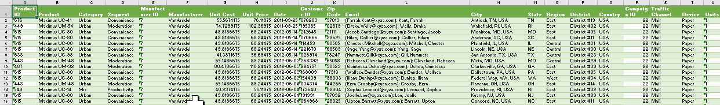
How do you turn a common Excel report into a Data Model
Denormalized to a Data Model
One Excel sheet with multiple columns
What am I counting or aggregating (FactTable)
How we describe the data
By Product Category
By Product Segment
By Campaign
By Customer
Notes:
Class Exercise, how would you split this up.
Have the class try to sort these into the different tables and see how they do. If time, come back to this after they learn about Fact tables and Dims to see if they would change it

Slide 48
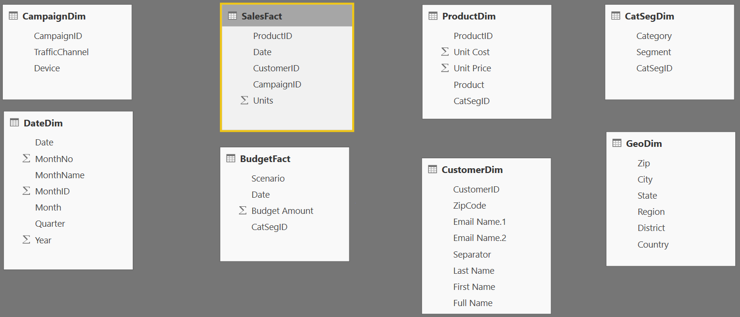
You have access to the data for your model, but it is not in the right “Shape”
Import Data Walkthrough
Start with basic Get Data queries to bring data in to the Query Editor
Use a combination of the UI and M to transform data into a streamlined data model
Notes:
We need to perform several transformations to create reporting for the VanArsdel Company.
Walk thru the granularity differences of the data model
SalesFact
By Campaign
By Date (dProduct – and By Product Category/Segment
By Customer – with Zips by Geo
BudgetFact
By Date (month)
By Product Category/Segment
ay)
By

Slide 49
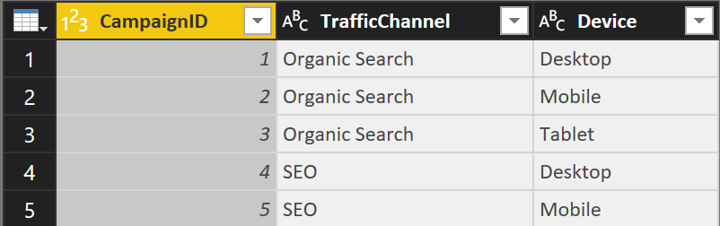
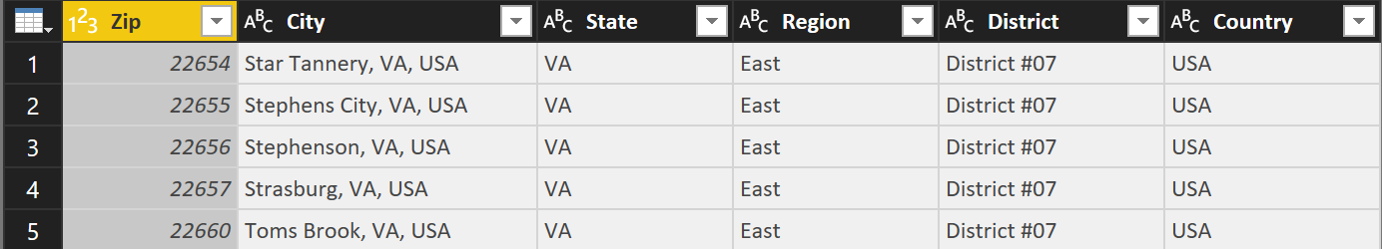
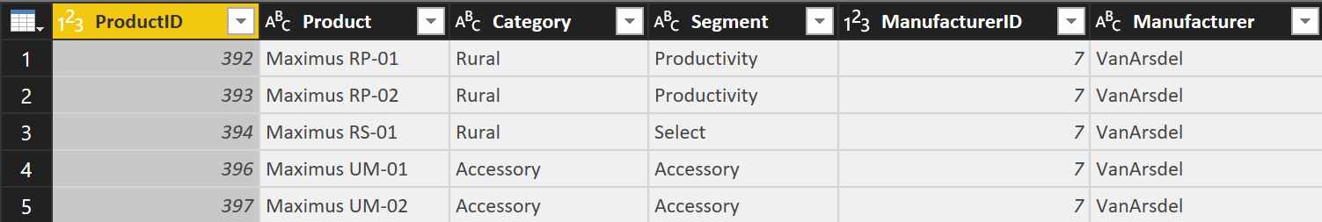
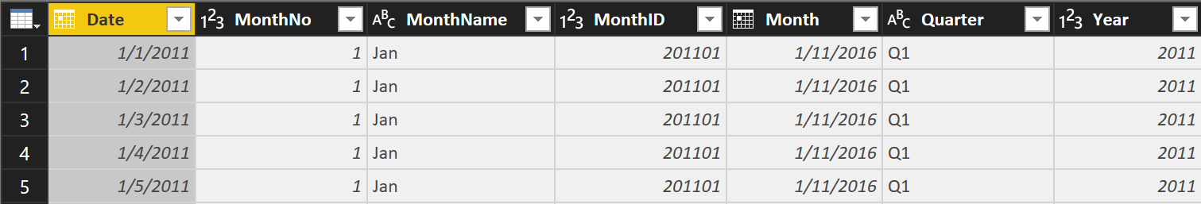
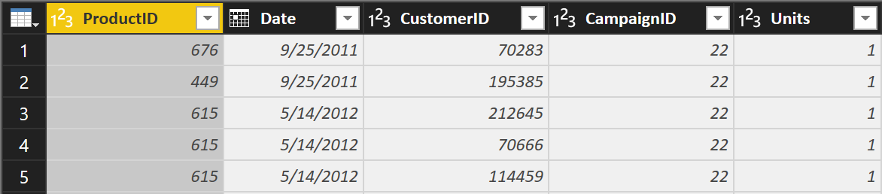
If the Source mirrors the Table required by the Model, import multiple tables at once
Module 2 Lab: Import Multiple Tables from a Single Source
CampaignDim
GeoDim
ProductDim
DateDim
Sales
Notes:
VERSION CHECK!!
StepxStep (Student Handout Slide 2)
Objective: Import multiple worksheets from an Excel file in one step
Get Data > from Excel
C:\Power BI_Adv_M\VansArsdel_Actuals.xlsx
Select the following Tables (All but CustomerDim):
CampaignDim
GeoDim
ProductDim
DateDim
Sales
In GeoDim, change the [ZIP] Data Type to Text

Slide 50
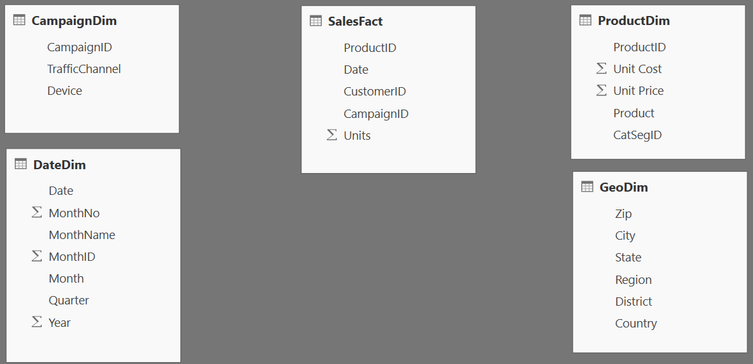
This is the current state of our data model
Module 2 Lab Exercise
Relationships will be “drawn” when the model is loaded
Notes:
Walk thru the granularity differences of the data model
SalesFact
By Campaign
By Customer – with Zips by Geo
By Date (day)
By Product – and By Product Category
BudgetFact
By Date (month)
By Product Category
Be sure to state that the users won’t see this model because they are in Query Editor

Slide 51
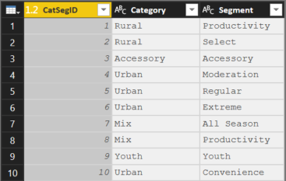
Extract unique combinations of Categories & Segments from the Product Dimension
Module 2 Lab: Create CatSegDim (Category Segment)
Add Index
CatSegDim is a Degenerate Dimension It is extracted from the data in the fact table.
Notes:
Ok, so we know we are missing a good way to relate all product sales to Category & Segment, and remember we do not want unneeded data! So let’s start by creating our own Dim table for Category & Segment for Products.
In the Data Modeling/DAX Class, we discuss details on why we always want to make our relationship joins using numeric (integer) fields. Rather than create two dimensions, one for Product and one for Product Segment, show Table.AddIndexColumn properties, show students how to read each argument, and make updates in the formula bar.
Walk through the Applied Stwe are using the distinct combinations of the two fields to create new combo dimension.
When the students need to select Categorymultiple columns, they can use CTRL + Click for multi-select.
Go to Power Query Formula Languages URL and eps.
Explain best practices for data type (i.e. get rid of any data type Any). Explain data typing done in the Query Editor while formatting is done in the main desktop window
StepxStep(Student Handout Slide 3)
Objective: Create the Product Category Segment Dimension by extracting Categories and Segments from the ProductDim
From the View ribbon uncheck “Always Allow”
Duplicate the ProductDim query
Highlight [Category] and [Segment], and Remove other columns
Highlight [Category] and [Segment], and Remove Duplicates
Add Column > Add Index Column starting at 1, with column name [CatSegID]
Reorder Columns: [CatSegID], [Category], [Segment]
Rename the query “CatSegDim”

Slide 52
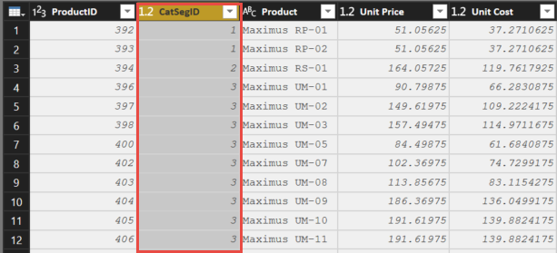
Apply new CatSegID field to the Product Dimension
Module 2 Lab: Update Product Dim
Replace with Index
Notes:
CTRL+Click to highlight multiple columns
During the Merge: call out that merges on multiple columns need to be selected in the same order in both tables. The columns with 1 & 2 need to be in the same order.
Discuss the Join kinds, and note that we will show them more on that later.
StepxStep(Student Handout Slide 4)
Objective: Add Product Category Segment ID in the ProductDim
Select the ProductDim query
From Home Ribbon > Merge Queries > Select ProductDim
From ProductDim, highlight [Category] and [Segment]
From CatSegDim, highlight [Category] and [Segment]
Note the Join Kinds available, and leave Left Outer
Expand the [NewColumn] > Select [CatSegID] and deselect “Use Original column name as prefix”
Remove columns: [Category], [Segment], [Manufacturer ID],and [Manufacturer].
Hint: There is only one manufacturer name and one manufacturer ID, so we don’t need this information!
Reorder columns: [ProductID], [CatSegID], [Product], [Unit Price], [Unit Cost]

Slide 53
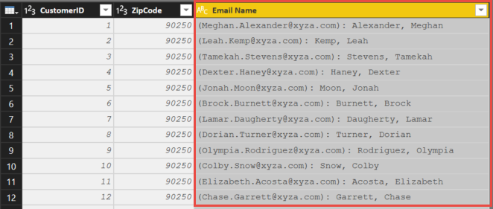
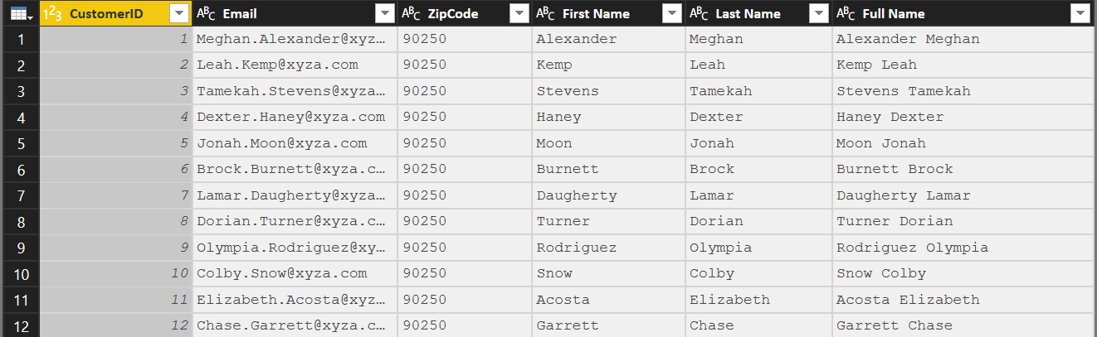
Using a garbage column to fill out CustomerDim
Module 2 Lab: Create Customer Dimension
Key Formulas:
Text.PositionOf()
Text.Start()
Text.Range()
Notes:
Let’s move on to the Customer table. What is happening here? (Email Name has email, last name, first name in one column). We need to clean this up!
I define a Garbage column as one that has everything AND the kitchen sink. Has multiple attributes and needs to be spit to work properly.
In a real world situation, you would simply use Split by Delimiter rather than use Text.PositionOf(), but this exercise allows us to explore some M Text functions.
StepxStep(Student Handout Slide 5)
Objective: Create a First, Last, and Full Name columns based on the Email Name column.
Use Recent Sources to get CustomerDim from Excel
Change the Zip Code column type to TEXT
Highlight the Email Name column, then Split Column > by Delimiter, select Custom and enter “: “ (colon with a space) *See troubleshooting below
Replace to Remove ( and )
Add Column to find Text.PositionOf() the comma
Add Column > Custom Column
Name = “Separator”
Formula = Text.PositionOf([Email Name.2],",")
Use position of comma to split Last Name and First Name Add Columns for First Name, Last Name and Full Name Last Name = Text.Start([Email Name.2],[Separator]) First Name = Text.Range([Email Name.2],[Separator]+2) Full Name = [First Name] & " " & [Last Name]
Troubleshooting – if they did NOT do a custom split by delimiter and do the “: “ (colon and space) then they can >”Trim the blank space in front of the last name in the new column by right clicking on the column header Email Name.2 and select Transform>Trim” after they complete step 4 adding the Separator column

Slide 54
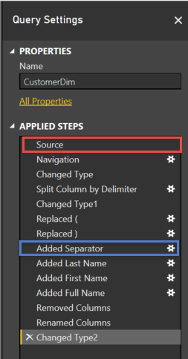
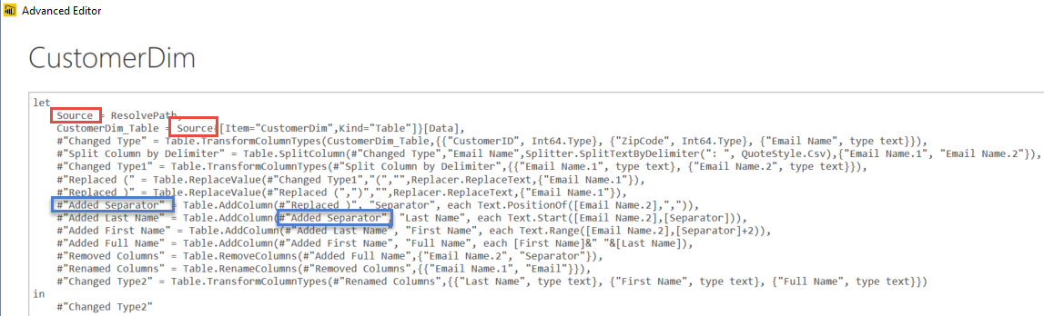
Module 2 Lab: Advanced Editor
Notes:
The advanced editor holds all of the code generated by the UI (user interface) and code updated in the formula bar.
Each line of code in the advanced editor has the syntax:
Variable = Line of Code
Each subsequent line references the Variable in a previous line of code
Note: It is NOT mandatory that a line of code reference the Variable in the IMMEDIATELY Previous line of code.
Example: You can create variables (hard coded or dynamically) and reference them later.
//Add single line comments by prefacing the line with “//”
/* Add Multiple
Line comments by surrounding them with “/* <Comment> */”
If a variable name has a space ( ) or special character (_-&) in them they must be surrounded with #”variable name”
Also, it is MUCH easier to rename a Step in the “Query Settings” by right+clicking and selecting Rename, than trying to do the rename directly in the advanced editor (as you need to ensure to fix both appearances of the name)
You can also change in Advanced Editor the last row “Changed Type2” to one of the other names to the left of the = and then show in Applied steps how that affect it. Then change it back.

Slide 55
KNOWLEDGE CHECK
You cannot import multiple tables from a single source (T/F)?
FALSE
Why would we need a snowflake dimension?
What syntax would you use to find out if a column has “Abc” as its first three character?
Or Last three?
Notes:
FALSE – you CAN import multiple tables from a single source
A snowflake dimension can be useful to remove duplicating fields from a large dimension. Or to use the snowflake for a primary dimension off a second fact at a higher grain.
Text.StartsWith([Column], “Abc”)
Text.EndsWith([Column], “Abc”)

Slide 56
Module 3: Advanced M Transformations

Slide 57
MODULE OBJECTIVES
Objectives
Understand M transformations
Understand Merge and other combining queries
Understand how to use multiple queries in an advanced transformation
Agenda
Power BI M Key Transformations
Power BI M Merge Types
Create BudgetFact using multi-query approach
Notes:
In the first module, we explored the data components of the Power BI architecture and best practices in data modeling. Along the way, we learned some Power BI terminology and how to organize our data within the tool.
Now, we will explore the M language, the Power BI power query language to deepen our knowledge and walk through how to import data from a variety of sources
Power Query (M) provides amazing ways to create powerful insights & layers to your reports where nothing existed before. The ability to create your “recipe” and transform you tables can separate you as a professional. The ceiling is high!
You can combine tables, you can not just “split” data but Group data to get relationships that didn’t exist. For example, if we anted to see an Attribute model of the first Opportunity campaign… there is a lot.
So we are going to review some of the heavy features. These can make your table completely different. If you know what you can do, then you can see your ugly table as what you want it to be! I honestly think of it as an artist or a web developer. Do you know what you want to do, or what you want to see? You can do that here.

Slide 58
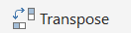
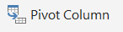
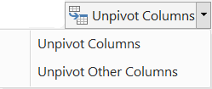
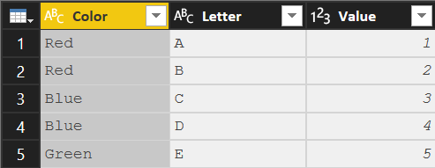
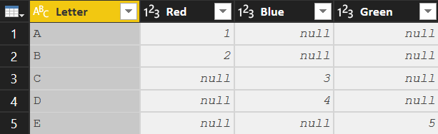
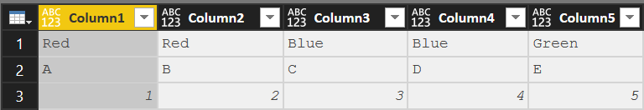
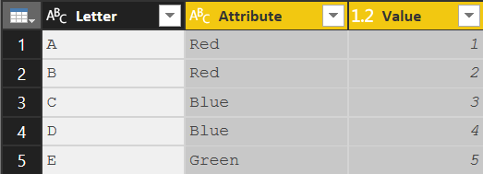
Key Transformations
Transpose
Convert Rows to Columns and Columns to Rows
Syntax: Table.Transpose(Previous)
Column headers are lost
To transpose column headers, demote them to data prior to transpose
Pivot Column
Convert Selected column of values into Column Headers
Syntax:
Table.Pivot(Previous,List.Distinct(Previous[Color]), "Color", "Value", List.Sum)
The values in [Color] column are converted to headers
The values in the [Value] column are filled in where applicable
Unpivot Columns
Convert Selected Column Headers into a column of values
Syntax:
Table.UnpivotOtherColumns(Previous, {"Letter"}, "Attribute", "Value")
The unpivoted column headers become the column [Attribute]
The unpivoted values become the column [Value]
Note: Previous => Name of the previous step in the query
Notes:
Transpose = taking everything that is a column and making it a row (all of the data what was a row becomes a column and what was a column becomes a row with the headers being lost.
Pivoting = in excel in a pivot table and something is on a row (i.e colors) I am now spreading those colors out to the right in their own column. Unpivoting is moving from columns to rows

Slide 59
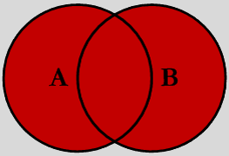
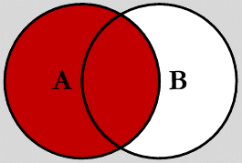


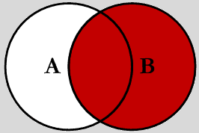
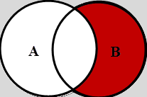
Join Kinds – Merge types
Full Outer (JoinKind.FullOuter)
Shows all of the rows from both queries. Like SQL “Union All”
Left Outer (JoinKind.LeftOuter) Default for Merge
Shows all rows in 1st query (A) and “paints” attributes from second query (B) based on matches in joined column(s).
Left Anti (JoinKind.LeftAnti) Shows ONLY rows in 1st (A) query where there is NO MATCH to 2nd query (B) based on joined column(s)
Inner (JoinKind.Inner)
Limits the rows to ONLY those which Match on joined column(s)
Right Outer (JoinKind.RightOuter) Shows all rows in 2nd (B) query and “paints” attributes from 1st query (A) based on matches in joined column(s)
Right Anti (JoinKind.RightAnti) Shows ONLY rows in 2nd (B) query where there is NO MATCH to 1st query (A) based on joined column(s)
Note: One or Multiple columns can be used to create the join
Notes:
A has 50 rows and B has 75 rows
Full Outer = You will have everything that matches so at least 75 rows if everything from A matches B. But if there are some that don’t match, we will get those additional rows.
Inner = We can have no more than 50 rows in the output and only those that share the same value (MATCH)
Left Outer = Only 50 rows with the additional columns that match from B (null if there is no match)
Right Outer = 75 rows from B and additional columns that match from A (null if there is no match)
Left Anti – is an UNMATCHED query: Give me all of the records in table A (Left) where there is NOT a match in table B (Right)
Right Anti – is an UNMATCHED query: Give me all of the records in table B (Left) where there is NOT a match in table A (Right)
Example = great to determine if every attribute in your dimension also resides in your fact table and vice versus.

Slide 60
Join Kinds – Other Combining Queries
Merge Combines attributes (columns) of two queries based on a joined columns(s)
Column(s) used for the join must be in both queries (can be one or more)
Both queries rerun with each execution
In Database terms, this is a JOIN
Append “Stack” records of two (or more) queries
Both (all) queries rerun with each execution
Like column headers must be named the same
Non-matching columns will be added to the right as extra colunns
Duplicate
Copies a query at a point in time (Save As)
Duplicate query can be modified independently without altering the original query
Executing the 2nd query (duplicate) does NOT execute the 1st (original) query
Reference Uses the output of one query as the INPUT in another query. (Link in a chain)
All subsequent changes made to 1st query affect the 2nd during refresh
When the 2nd query executes, it re-executes all the steps in the 1st query
Notes:
Merge = Based on the type of Merge we are combining attributes from two queries. Merge is like a VLookup
Append = stacking attributes based on column header names (i.e. Country in DIAD) is when you would copy and paste rows to a worksheet (insert cells, etc)
Duplicate = will only see the steps 1-5 from Query A if duplicate is done at that point. Whatever that query is at that point even if steps are added later in Applied Steps above the initial steps 1-5.
Reference = if I make a reference from query A after step 5 to a new Query B and make additional steps 6-10 then Query B will also be affected by those additional steps.

Slide 61
Module 3 Lab:
Complex Transformation

Slide 62
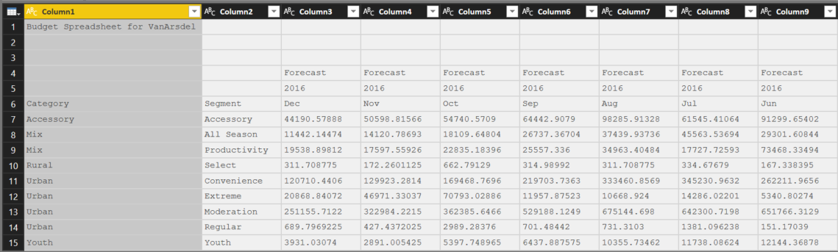
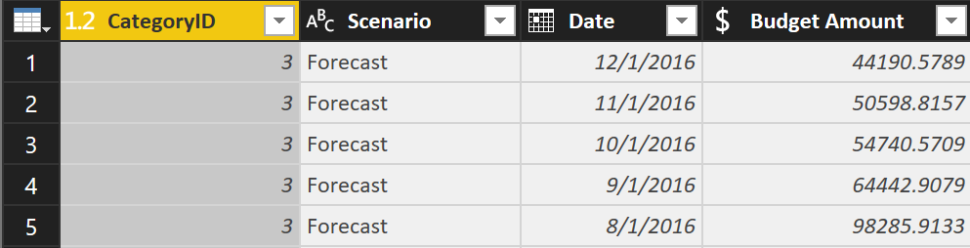
Objective: Transform a “wide” Budget file with three extra rows on top and a three row header into a usable BudgetFact table
Module 3 Lab: Create Budget Fact
Notes:
This slide does not have actions, just discuss at a high level what we WILL be doing and why. We are combining rows 4, 5, and 6 so that we can then unpivot the data.

Slide 63
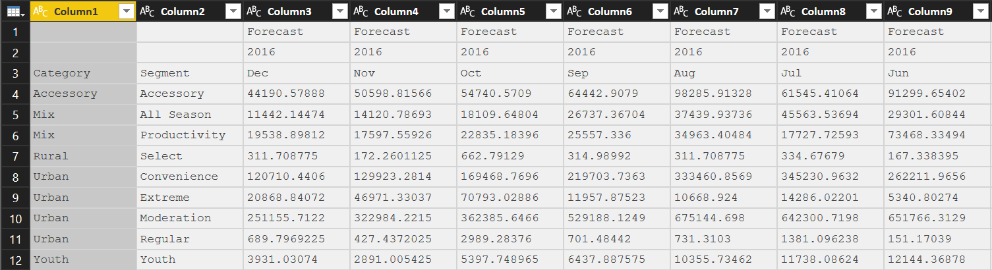
Import CSV, remove blank rows, and rename query to BudgetFact_Data
Module 3 Lab: Create Budget Fact
Notes:
Review the drop downs for Delimiter and Data Type Detection in the Navigator
StepxStep(Student Handout Slide 6)
Objective: Create the Budget Fact
Import CSV document “C:\Power BI_Adv_M\VanArsdel_Budget.csv”
Rename query from VanArsdel_Budget to BudgetFact_Data
Remove Rows > Remove Top Rows, enter 3 (to remove the first 3 rows)

Slide 64
Create a Duplicate, and Extract just the Header Rows into a separate query
Module 3 Lab: Create Budget Fact
Notes:
The data set we are working with that we would not necessarily need to break the header into its own query, but in a real model with more data, this method is good because it is less memory intensive.
StepxStep(Student Handout Slide 7) the first three rows
Duplicate query BudgetFact_Data rename to “BudgetFact”
Keep Rows > Keep Top Rows,
Objective: To Create a Header which combines enter 3 (to keep the first three rows)

Slide 65
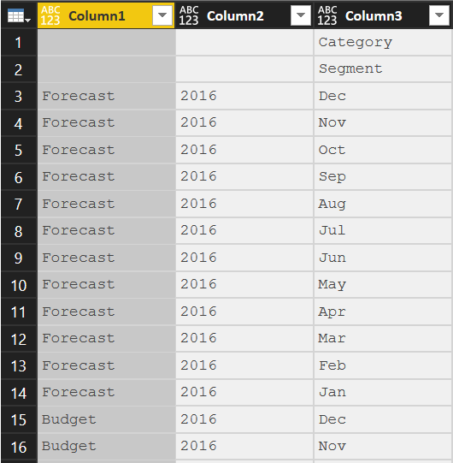
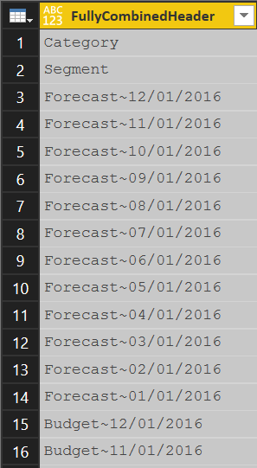
Transpose headers, combine into a single column, and transpose back
Module 3 Lab: Create Budget Fact
Notes:
Create Budget Month first as Date.From ([Column3] & [Column2])
Note the errors in rows 1 & 2 as the formula does not resolve to a proper date. Explain how wrapping the formula in try / otherwise resolve the error.
Show Date.ToText[Budget Month], “M/D/Y”) with all uppercase to discuss how the date formatting is case sensitive.
Also, we are using the ~ as a delimiter to make our scenario and date easier to split later. Date Formatting: MM=Month; dd=Day; yy=Year; hh=Hour, mm=Minute; ss=Second
StepxStep(Student Handout Slide 8)
Objective: To Create a Header which combines the first three rows
Transform > Transpose
Add Column > Custom Column
Add Column to combine month and year into a date
Add Column > Custom Column
Name = “Budget Month”
Formula = try Date.From ([Column3] & [Column2]) otherwise null
Add Column to combine Month and Scenario
Add Column > Custom Column
Name = “FullyCombinedHeader”
Formula = if Text.Length([Column3]) > 3 then [Column3] else [Column1] & "~" & Date.ToText([Budget Month], "M/D/YYYY")
Hint: Day did not come through correctly, as it is case sensitive. Update to “MM/dd/yy”
Remove all columns except for [FullyCombinedHeader]
Transform > Transpose to transpose back to wide

Slide 66
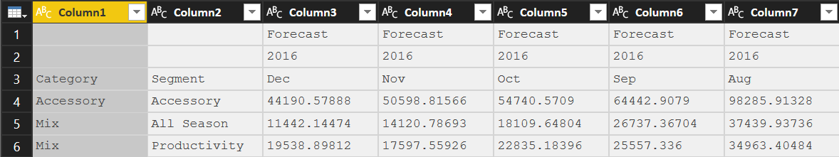
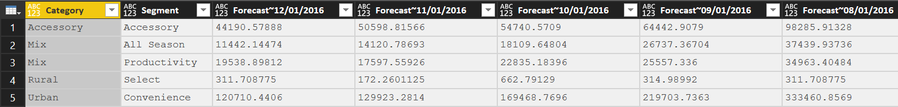
Append BudgetFact_Data to the bottom of the headers, then remove the extraneous header rows, finally set first row as header
Module 3 Lab: Create Budget Fact
Notes:
StepxStep(Student Handout Slide 9)
Objective: To Append the new header row to the data to create the new wide data table with a single header row
Append query BudgetFact_Data
Use First Row as Header to promote the newly fixed header row
Remove Rows > Remove Top Rows, enter 3 (to remove the first 3 rows – the old header rows)

Slide 67
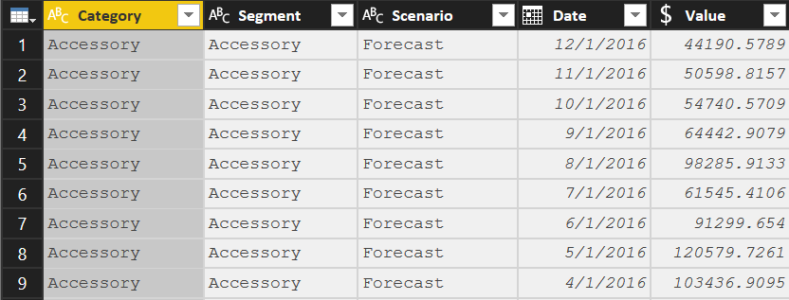
Unpivot Forecast Columns, Split and Rename them, then set data types
Module 3 Lab: Create Budget Fact
Notes:
StepxStep(Student Handout Slide 10)
Objective: Create the Budget Fact
Highlight [Category] and [Segment] and Transform > Unpivot Other Columns
Highlight [Attribute] and navigate to Home > Split Column > By Delimiter > “~”
Rename: [Attribute.1] = “Scenario”, [Attribute.2] = “Date”, [Value] = “Budget Amount”
Change the Data Types: [Budget Amount] = Fixed Decimal, [Date] = Date

Slide 68
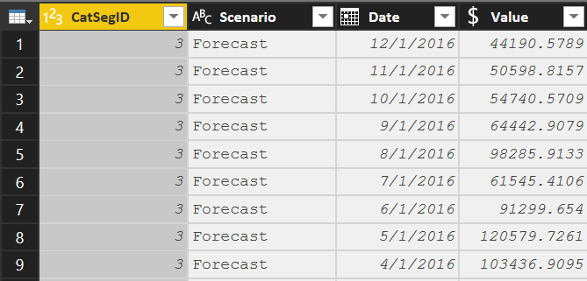
Merge in CatSegID and remove extraneous columns
Module 3 Lab: Create Budget Fact
Notes:
StepxStep(Student Handout Slide 11)
Objective: Merge the queries together to create the final Budget Fact table
Home > Merge Queries > Select CatSegDim
From the CatSegDim highlight both [Category] and [Segment]
From BudgetFact, highlight both [Category] and [Segment]
Show the Join Kinds available, and leave “Left Outer”
Expand [NewColumn] > Select “CatSegID” and deselect “Use Original column name as prefix”
Remove: [Category], [Segment]
Reorder: [CatSegID], [Scenario], [Date], [Budget Amount]
Disable the load of BudgetFact_Data

Slide 69
KNOWLEDGE CHECK
Which transformation type turns all rows into columns and columns into rows?
Transpose
Which Merge type would you use to get all rows from two queries, even if the joined column(s) did not match?
Full Outer Join
What happens in an Append if the column names do not match?
Extra Columns are added to the right of the source table.
Notes:
Transpose
Full Outer Join
Extra Columns are added to the right of the Joining columns. If the field did not exist in the source for the row, then the field is null

Slide 70
Module 4: Variable and Parameters

Slide 71
MODULE OBJECTIVES
Objectives
Understand what Variables and Parameters are how they can be used
Understand the benefits to parameterizing your queries
Understand what “Enter Data” is and how it can be used
Understand how to organize your queries using folder groups
Agenda
Power BI M Variables & Parameters
Enter Data
Leveraging Variables & Parameters
Create Change Log

Slide 72
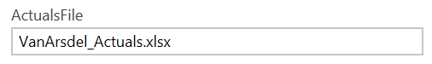
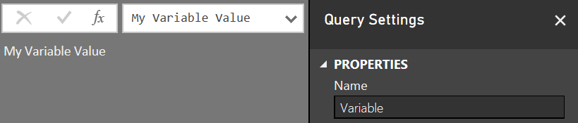


Variable and Parameters
M Variables
Query with a constant value, table or list result
Create with a new blank query
Query name is the Variable name to use in other queries
Type the variable value in the formula bar
Advanced Editor would look like this:
M Parameters
Parameters take Variables to the next level.
Parameters can be any VALID data type
The most common are hard keyed single, switchable values
The values list for a parameter can also come from a query that is formatted as a LIST
Parameter used as Source Input
Parameter Usage
Be Creative!
SQL Server
For Database Name
For Server (Switch Dev, Test, Prod)
“Where Clauses” in SQL Queries
To pull all Orgs, or just a single one
SharePoint Team site names
If they are based on a template, you can easily share queries
File Paths and File Names
Have a single place where you need to make a change

Slide 73



User Enter Data to add a table on the fly. They make great mapping tables.
Enter Data
<- To add additional rows or columns later, click the gear icon.
Notes:
Enter Data is a function which allows you to create the equivalent of a “Linked Table” within the Query Editor.
They can be an easy way to create a manual Mapping table or a Change Log within the file.

Slide 74
Module 4 Lab:
Creating Parameters and Paths

Slide 75

All of the queries in our file are dependent on the file being in a specified path
Module 4 Lab: File Source considerations
If you move the source file and try to refresh the queries you will receive an error
C:\ to File Share
Different folder location
To SharePoint
To OneDrive
Each query will need to be changed EACH time the file is moved
Creating Parameters with Dynamic Paths resolves this issue

Slide 76

Create Parameters
Module 4 Lab: Create Parameters
Actual File
Budget File
Path
Notes:
Explain the Suggested Values drop down field
StepxStep(Student Handout Slide 12)
Objective: Update file paths to use dynamic variables
From the Home Ribbon > Manage Parameters
Create a new Parameter
Parameter Name: Path
Type: Text
Current Value = C:\Power BI_Adv_M\
Important that this matches the file name that the student has on their C Drive. If they don’t have the underline but they have spaces in the folder name then this needs to match their folder
Create a new Parameter
Parameter Name: Actuals_File
Type: Text
Current Value = VanArsdel_Actuals.xlsx
Create a new Parameter
Parameter Name: Budget_File
Type: Text
Current Value = VanArsdel_Budget.csv
Update the text files to ensure the parameter names are consistent

Slide 77


Use blank query to create Dynamic Path
Module 4 Lab: Dynamic Path to Excel Source File
Uses Blank Query
Populate Advanced Editor of query with text from file provided
For each query which uses the Excel source, update the Source (applied step) with the new variable name =Actuals_Path
Notes:
StepxStep(Student Handout Slide 13)
Objective: Create a query to validate if source is Web or Local and resolve path
Create a new blank query
Query Name: “Actuals_Path”
Open Advanced Editor and copy the text from the Actuals_Path.txt
If you need to troubleshoot:Text as shown in slide (white box) with the correction above
Update Source Applied Step to use Resolved Path = “Actuals_Path” to all of the following queries:
CampaignDim
CustomerDim
ProductDim
CatSegDim
DateDim
GeoDim
SalesFact

Slide 78


Use the Actuals_Path query as a variable in other queries
Module 4 Lab: Dynamic Path to Excel Source File
In Advanced Editor, update the Excel source to the new Actuals_Path source.
Original
Updated
Notes:
(Student Handout Slide 14)
You can also do this in Query Editor using the Applied Steps.

Slide 79


Follow a similar patter to make the Budget CSV file dynamic
Module 4 Lab: Dynamic Path to CSV Source File
Uses Blank Query
Populate Advanced Editor of query with text from file provided
For each query which uses the Excel source, update the Source (applied step) with the new variable name =Budget_Path
Notes:
StepxStep(Student Handout Slide 15)
Objective: Update CSV file paths to use dynamic variables
Create a new blank query
Query Name: “Budget_Path”
In Advanced Editor
Copy in text from Budget_Path.txt
Update Source Applied Step to use ResolvedBudgetPath = “Budget_Path” for the following Queries:
BudgetFact
BudgetFact_Data

Slide 80


Use Enter Data to create a Change Log
Module 4 Lab: Create a Change Log
Create a table within query to house the change log
Name the query Change Log
Update table each time a change is made to the code
If you decide to load file to data model, then you have the ability to report on current version and last update date
Report
Notes:
You can add rows and columns to the Query using the gear next to Source
(Student Handout Slide 16)

Slide 81

Use Folders to Group Queries
Module 4 Lab: Organize your Queries
Create logical groups to Manage your queries
Can create sub-groups
Use Drag and Drop to move queries to folders
Notes:
(Student Handout Slide 16)

Slide 82


Use the M Language to create your own Custom Connector!
Custom Connectors
Samples and SDK on github
https://github.com/Microsoft/DataConnectors
Notes:
(Student Handout Slide 16)

Slide 83
KNOWLEDGE CHECK
A Parameter can be used to easily switch your queries to a different Server (T/F)?
Provide one example for usage of Enter Data?
Advantages to putting queries in Query Groups (folders)?
Notes:
True – the Parameter makes this easy as all of the possible values can be populated, so the user just has to choose.
Change Log or Mapping Table
Easier to keep the code organized.

Slide 84
Appendix A:
Knowledge Check Answers

Slide 85
KNOWLEDGE CHECK Answers – Module 1
What allow tables in the data model to “talk” to one another?
Relationships
What type of schema has all attributes for model in a single table?
Denormalized or “Flat” – the Kitchen Sink Schema
When would you use multiple Fact tables
Multiple Reasons
Different Time Grains
Different dimensional attributes
One dimension at different grain: Product v. Product Category
Facts are sourced from different systems with different refresh cadences.
Notes:
Relationships
Denormalized or “Flat” – the Kitchen Sink Schema
Multiple Reasons
Different Time Grains
Different dimensional attributes
One dimension at different grain: Product v. Product Category
Facts are sourced from different systems with different refresh cadences.

Slide 86
KNOWLEDGE CHECK Answers – Module 2
You cannot import multiple tables from a single source (T/F)?
FALSE – you CAN import multiple tables from a single source
Why would we need a snowflake dimension?
A snowflake dimension can be useful to remove duplicating fields from a large dimension. Or to use the snowflake for a primary dimension off a second fact at a higher grain.
What syntax would you use to find out if a column has “Abc” as its first three character?
Text.StartsWith([Column], “Abc”)
Or Last three?
Text.EndsWith([Column], “Abc”)
Notes:
FALSE – you CAN import multiple tables from a single source
A snowflake dimension can be useful to remove duplicating fields from a large dimension. Or to use the snowflake for a primary dimension off a second fact at a higher grain.
Text.StartsWith([Column], “Abc”)
Text.EndsWith([Column], “Abc”)

Slide 87
KNOWLEDGE CHECK Answers – Module 3
Which transformation type turns all rows into columns and columns into rows?
Transpose
Which Merge type would you use to get all rows from two queries, even if the joined column(s) did not match?
Full Outer Join
What happens in an Append if the column names do not match?
Extra Columns are added to the right of the Joining columns. If the field did not exist in the source for the row, then the field is null
Notes:
Transpose
Full Outer Join
Extra Columns are added to the right of the Joining columns. If the field did not exist in the source for the row, then the field is null

Slide 88
KNOWLEDGE CHECK Answers – Module 4
A Parameter can be used to easily switch your queries to a different Server (T/F)?
True – the Parameter makes this easy as all of the possible values can be populated, so the user just has to choose.
Provide one example for usage of Enter Data?
Change Log or Mapping Table
Advantages to putting queries in Query Groups (folders)?
Easier to keep the code organized.
Notes:
True – the Parameter makes this easy as all of the possible values can be populated, so the user just has to choose.
Change Log or Mapping Table
Easier to keep the code organized.

Slide 89
Appendix B:
Example of Data Flow diagram using Visio

Slide 90


Slide 91
Appendix C:
Extract all M queries in a PBIX

Slide 92



Extract M Queries

Slide 93
Appendix D:
Other M Topics

Slide 94

Hard code a Date or time literal into your query
Date and Time Literals

Slide 95

Access function documentation from within Edit Queries
#shared
Type =#shared in Power Query formula bar
Convert list to table
Sort list on function name
Click in whitespace next to function to see full UPDATED Help Text & Examples
If you click on the “Function” word, it adds a step to the Power Query focusing on that function

Slide 96


Access function documentation from within Edit Queries
#table
#table( { “title1”, ”title2”} , { { 0,1 }, { 1,0 }, { 0, 0 } } )
Create a table of hard-coded values
Use to append a null id field to existing pull which does not currently have the value

Slide 97
Recap of Object Types
M Object Types
Formula Expression – Evaluated expression which is computed to yield a result. The result can be a List, Record, Table or single (scalar) Value
List – An ordered sequence of values i.e. {1, 2, 3}
Field - A field is a name/value pair
Record - A set of fields. A field is a name/value pair where the name is a text value that is unique within the field’s record. For example: [CustomerID = 1, Name = "Bob"]
Operators M supports common Operators including >, >=, <, <=, =, <>, or, and, not, +, -, *, /, &

Slide 98

Example of Error handling in a formula
try…otherwise

